Slide 1
Halliday & Resnick’s
Fundamentals of Physics
Extended Edition Wiley
Chapter 15
Jearl Walker
Oscillations

Slide 2
15.1 Oscillatory motion
Motion which is periodic in time, that is, motion that repeats itself in time.
Examples:
Power line oscillates when the wind blows past it
Earthquake oscillations move buildings
  Sometimes the oscillations are so severe, that the system exhibiting oscillations break apart.

Slide 3
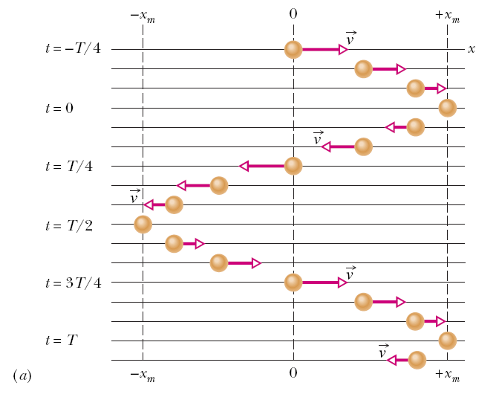
15.2 Simple Harmonic Motion
In the figure snapshots of a simple oscillatory system is shown. A particle repeatedly moves back and forth about the point x=0.
The time taken for one complete oscillation is the period, T. In the time of one T, the system travels from x=+x_{m}, to –x_{m}, and then back to its original position x_{m}.
The velocity vector arrows are scaled to indicate the magnitude of the speed of the system at different times. At x=±x_{m}, the velocity is zero.

Slide 4
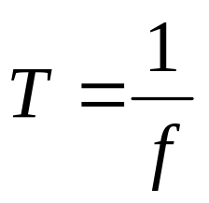
15.2 Simple Harmonic Motion
Frequency of oscillation is the number of oscillations that are completed in each second.
The symbol for frequency is f, and the SI unit is the hertz (abbreviated as Hz).
It follows that

Slide 5
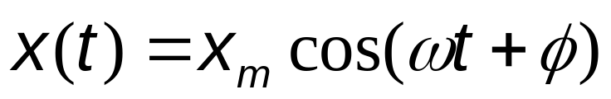
15.2 Simple Harmonic Motion
Any motion that repeats itself is periodic or harmonic.
If the motion is a sinusoidal function of time, it is called simple harmonic motion (SHM).
Mathematically SHM can be expressed as:
Here,
x_{m} is the amplitude (maximum displacement of the system)
t is the time
ω is the angular frequency, and
φ is the phase constant or phase angle

Slide 6
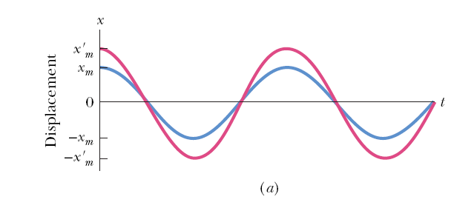
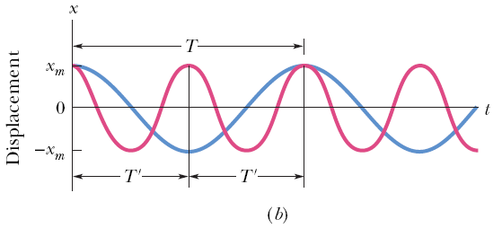
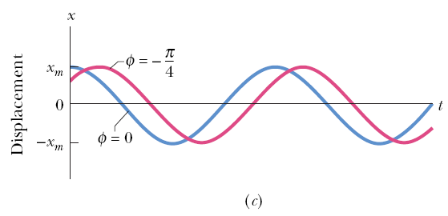
15.2 Simple Harmonic Motion
Figure a plots the displacement of two SHM systems that are different in amplitudes, but have the same period.
Figure b plots the displacement of two SHM systems which are different in periods but have the same amplitude.
The value of the phase constant term, φ, depends on the value of the displacement and the velocity of the system at time t = 0.
Figure c plots the displacement of two SHM systems having the same period and amplitude, but different phase constants.

Slide 7

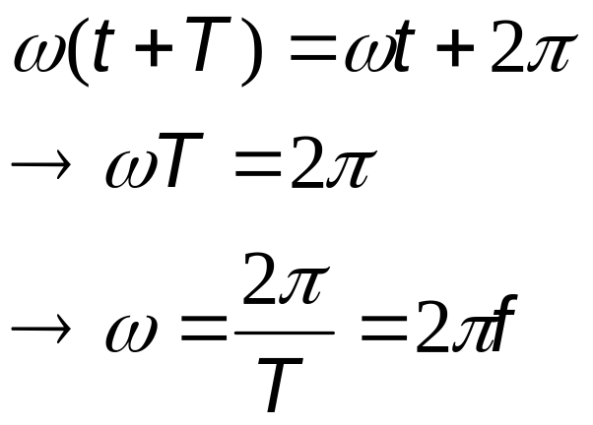
15.2 Simple Harmonic Motion
For an oscillatory motion with period T,
The cosine function also repeats itself when the argument increases by 2π. Therefore,
Here, ω is the angular frequency, and measures the angle per unit time. Its SI unit is radians/second. To be consistent, φ then must be in radians.

Slide 8
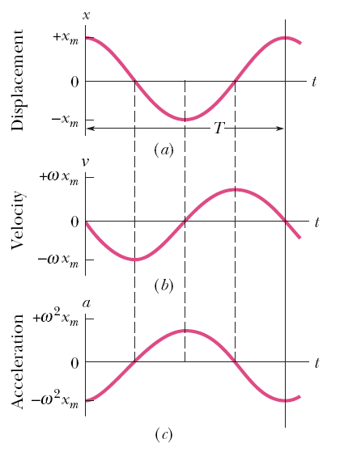
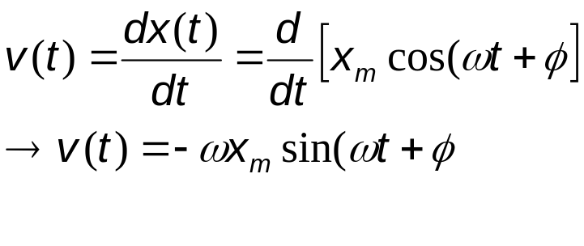
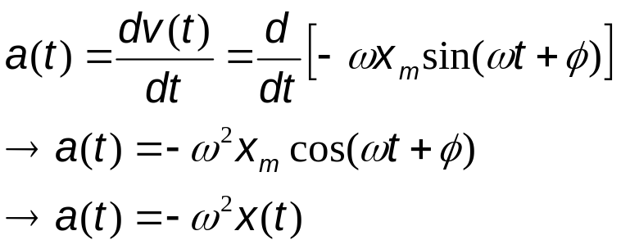
15.2 Simple Harmonic Motion
The velocity of SHM:
The maximum value (amplitude) of velocity is ωx_{m}. The phase shift of the velocity is π/2, making the cosine to a sine function.
The acceleration of SHM is:
The acceleration amplitude is ω²x_{m}.
In SHM a(t) is proportional to the displacement but opposite in sign.

Slide 9
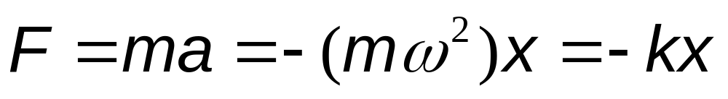
15.3 Force Law for SHM
From Newton’s 2nd law:
SHM is the motion executed by a system subject to a force that is proportional to the displacement of the system but opposite in sign.

Slide 10
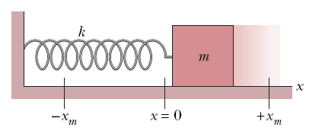
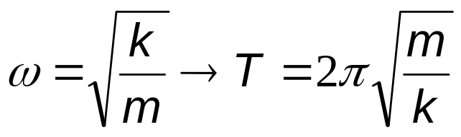
15.3 Force Law for SHM
The block-spring system shown on the right forms a linear SHM oscillator.
The spring constant of the spring, k, is related to the angular frequency, ω, of the oscillator:

Slide 11
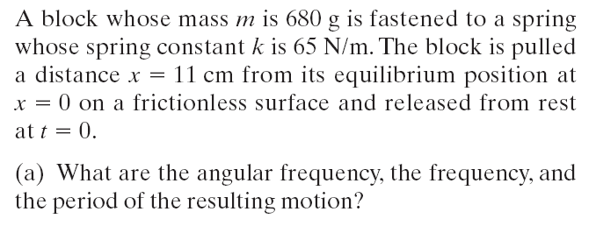
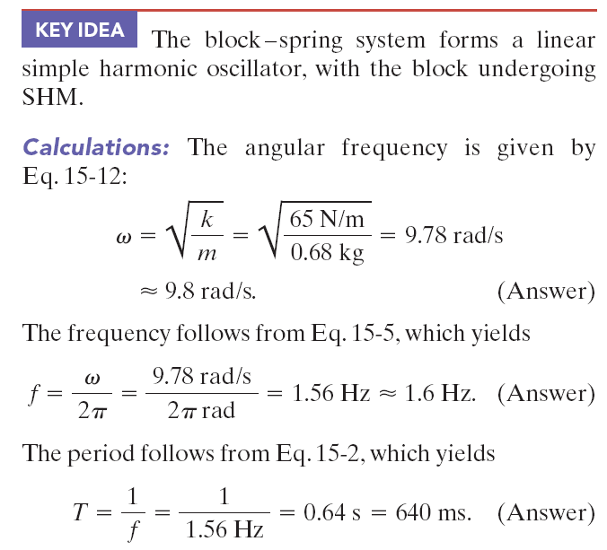
Example, force law:

Slide 12
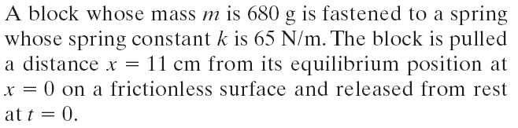
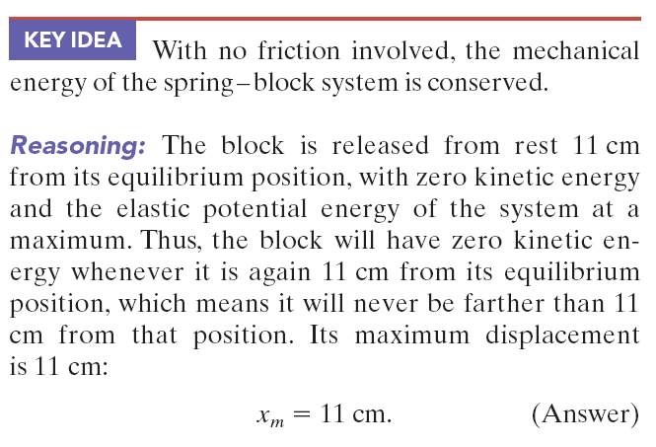
Example, force law:

Slide 13
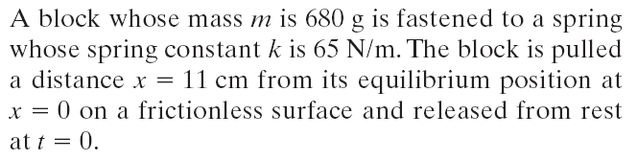


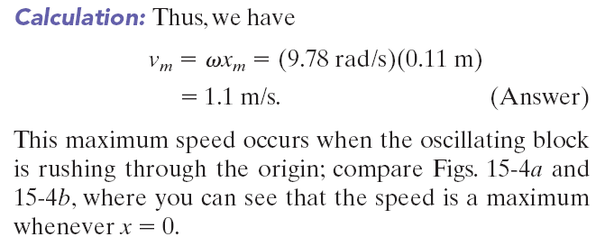
Example, force law:

Slide 14
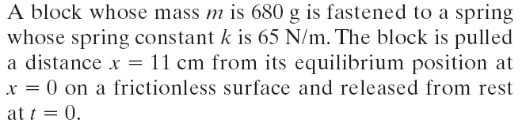

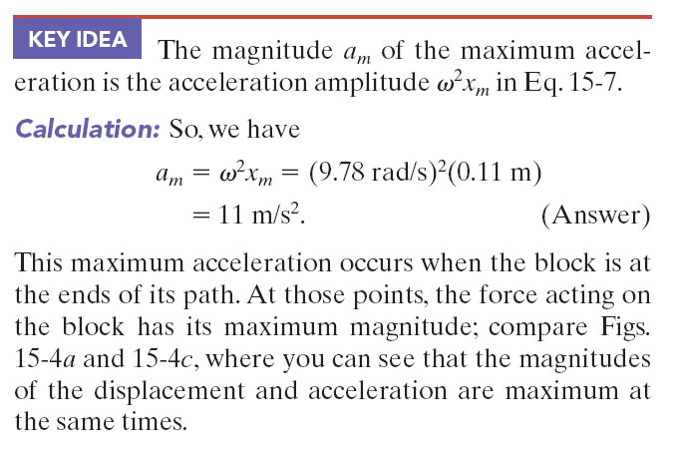
Example, force law:

Slide 15
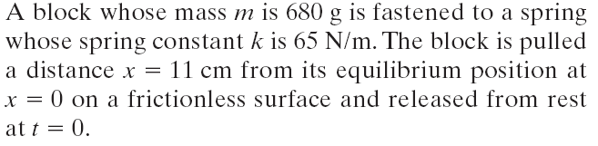
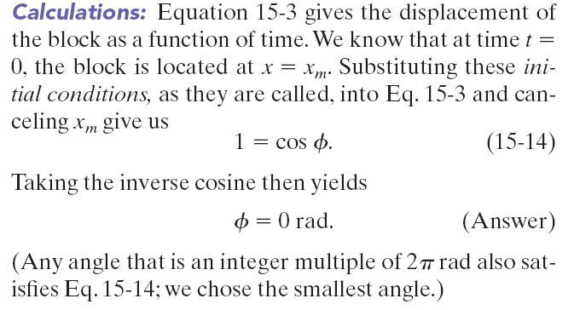
Example, force law:

Slide 16
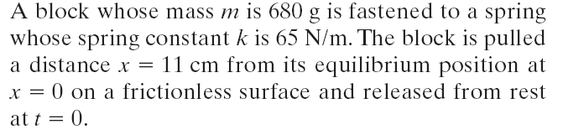

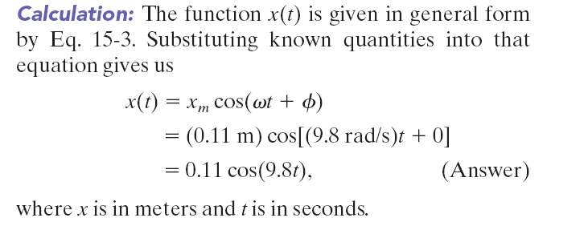
Example, force law:

Slide 17
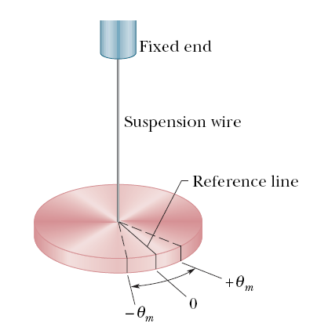
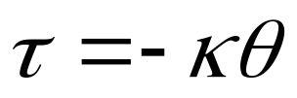
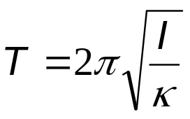
15.4: An Angular SHM
The figure shows an example of angular SHM. In a torsion pendulum involves the twisting of a suspension wire as the disk oscillates in a horizontal plane.
The torque associated with an angular displacement of θ is given by:
is the torsion constant, and depends on the length, diameter, and material of the suspension wire.
The period, T, relates to κ as:
Here, I is the rotational inertia of the oscillating disk.

Slide 18
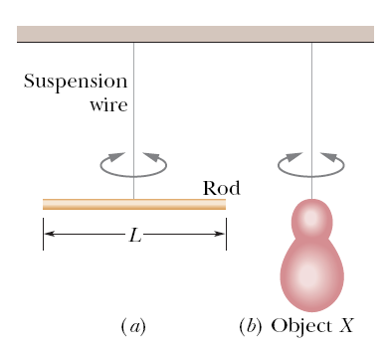


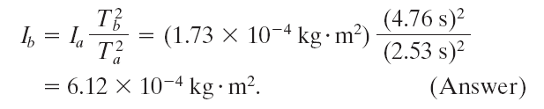
Example, angular SHM:
Figure a shows a thin rod whose length L is 12.4 cm
and whose mass m is 135 g, suspended at its midpoint
from a long wire. Its period T_{a} of angular SHM is measured
to be 2.53 s. An irregularly shaped object, which we
call object X, is then hung from the same wire, as in Fig. b, and its period T_{b} is found to be 4.76 s. What is the
rotational inertia of object X about its suspension axis?
Answer: The rotational inertia of either the rod or
object X is related to the measured period. The rotational inertia of a thin rod about a perpendicular axis through its midpoint
is given as 1/12 mL².Thus, we have, for the rod in Fig. a,
Now let us write the periods, once for the rod and once for object X:
The constant κ, which is a property of the wire, is the same for both figures; only the periods and the rotational inertias differ.
Let us square each of these equations, divide the second by the first, and solve the resulting equation for I_{b}. The result is

Slide 19
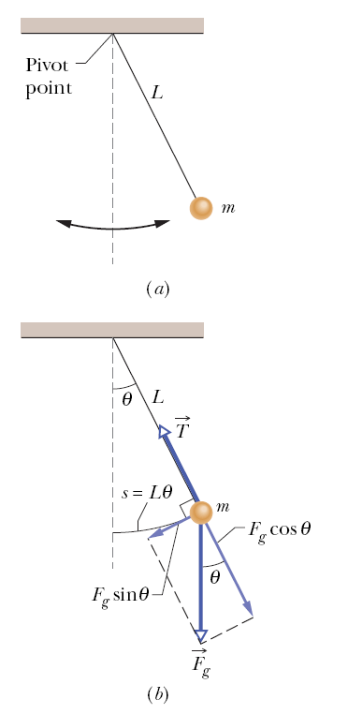
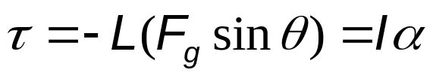
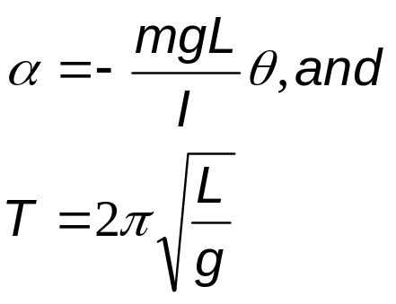
15.6: Pendulums
In a simple pendulum, a particle of mass m is suspended from one end of an unstretchable massless string of length L that is fixed at the other end.
The restoring torque acting on the mass when its angular displacement is θ, is:
α is the angular acceleration of the mass. Finally,
This is true for small angular displacements, θ.

Slide 20
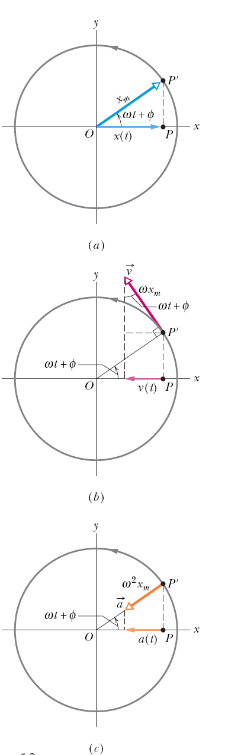

15.7: SHM and uniform circular motion
Consider a reference particle P’ moving in uniform circular motion with constant angular speed (w).
The projection of the particle on the x-axis is a point P, describing motion given by:
This is the displacemnt equation of SHM.
SHM, therefore, is the projection of uniform circular motion on a diameter of the circle in which the circular motion occurs.

Slide 21
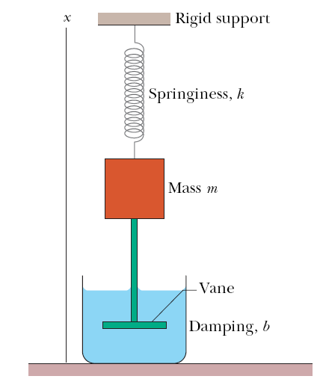
15.8: Damped SHM
In a damped oscillation, the motion of the oscillator is reduced by an external force.
Example: A block of mass m oscillates vertically on a spring on a spring, with spring constant, k.
From the block a rod extends to a vane which is submerged in a liquid.
The liquid provides the external damping force, F_{d}.

Slide 22
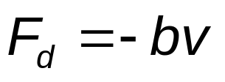
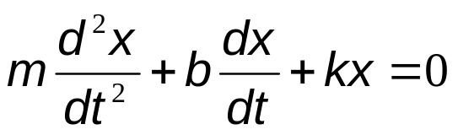
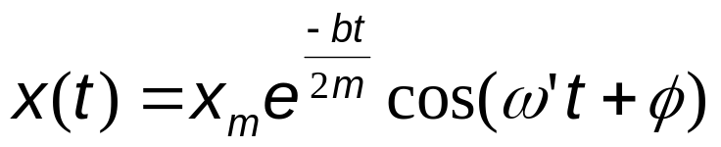
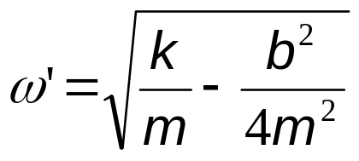
15.8: Damped SHM
Often the damping force, F_{d}, is proportional to the 1st power of the velocity v. That is,
From Newton’s 2nd law, the following DE results:
The solution is:
Here ω’ is the angular frequency, and is given by:

Slide 23
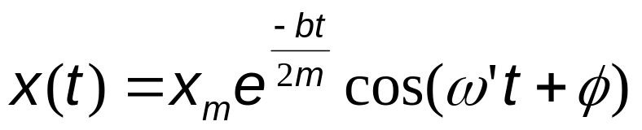
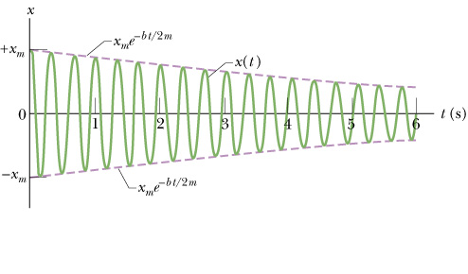
15.8: Damped SHM
The figure shows the displacement function x(t) for the damped oscillator described before. The amplitude decreases as x_{m} exp (-bt/2m) with time.

Slide 24
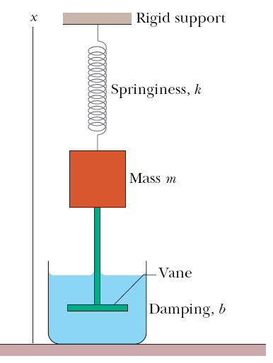
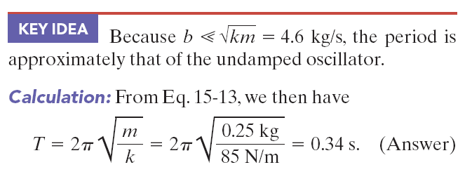
Example, damped SHM:
For the damped oscillator in the figure, m 250 g, k = 85 N/m, and b =70 g/s.
(a) What is the period of the motion?

Slide 25


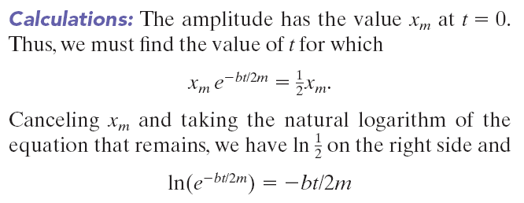
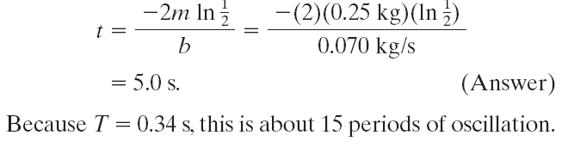
Example, damped SHM, continued:
(b) How long does it take for the amplitude of the damped oscillations to drop to half its initial value?

Slide 26
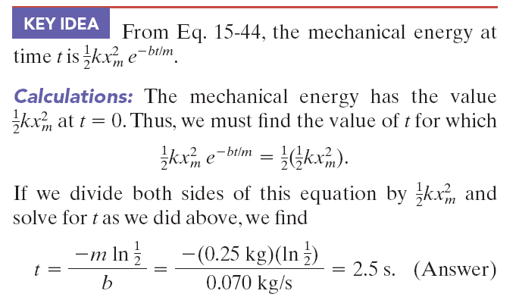
Example, damped SHM, continued:
(c) How long does it take for the mechanical energy to drop to one-half its initial value?

Slide 27
15.9: Forced oscillations and resonance
When the oscillator is subjected to an external force that is periodic, the oscillator will exhibit forced/driven oscillations.
Example: A swing in motion is pushed with a periodic force of angular frequency, ω_{d}.
There are two frequencies involved in a forced driven oscillator:
ω, the natural angular frequency of the oscillator, without the presence of any external force, and
ω_{d}, the angular frequency of the applied external force.

Slide 28
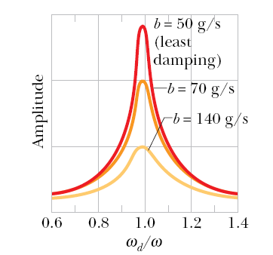
15.9: Forced oscillations and resonance
Resonance will occur in the forced oscillation if the natural angular frequency, ω, is equal to ω_{d}.
This is the condition when the velocity amplitude is the largest, and to some extent, also when the displacement amplitude is the largest. The adjoining figure plots displacement amplitude as a function of the ratio of the two frequencies.
Example: Mexico City collapsed in September 1985 when a major earthquake hit the western coast of Mexico. The seismic waves of the earthquake was close to the natural frequency of many buildings

